Slide 1
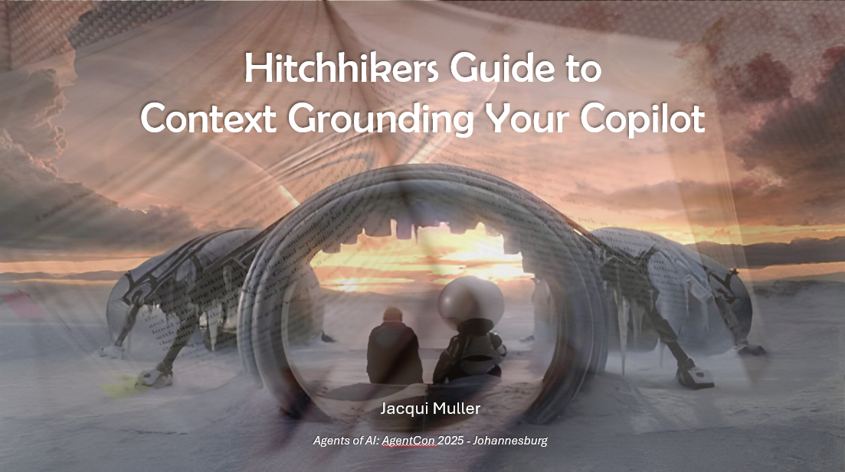

Slide 2
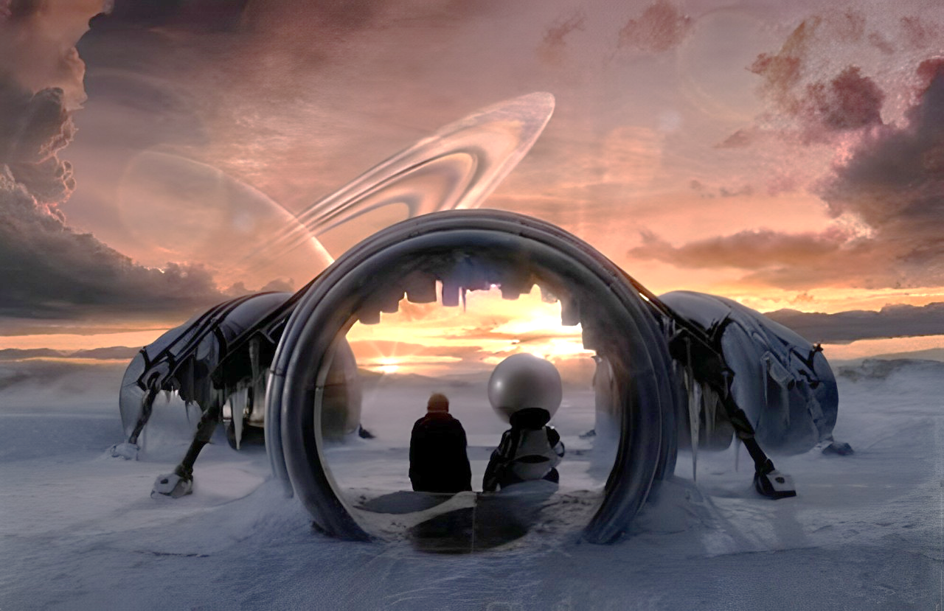

Hitchhikers Guide to
Context Grounding Your Copilot
Jacqui Muller
Agents of AI: AgentCon 2025 - Johannesburg

Slide 3











Jacqui Muller
Changing the world one solution at a time
UiPath MVP - Lecturer - Researcher - Solution Architect -
Enterprise Architect - Senior Automation Developer - Process
Analyst - Public Speaker - Business Owner - PhD Candidate -
LinkedIn Top Voice - UiPath AI Ambassador of the Year - Blogger
Jacqui.Muller@outlook.com
Notes:
As a brief introduction, my name is Jacqui Muller. I am the senior Automation Manager at NTT DATA in the MEA region. I am also affiliated the North-West University as a PhD student and a lecturer. I am recognised as a global industry expert of RPA with various well-established industry-leading accolades.

Slide 4

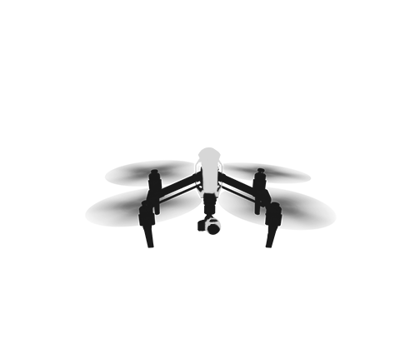

Hitchhikers Guide
What comes first? The question or the answer?

Slide 5
Hitchhikers Guide to the Galaxy – ELI5
Once upon a time there was a supercomputer named Deep Thought
It was created to calculate the answer to the Ultimate Question of Life, the Universe and Everything.
The question was posed to Deep Thought on the day of the Great On-Turning
Deep Thought inevitably had a lot to think about and gave an ETA of 7.5 million years for the answer
7.5 million years later… There was an answer
42
Notes:
Deep Thought was a supercomputer created by a race of hyper-intelligent pan-dimensional beings that was programmed to calculate the answer to the Ultimate Question of Life, the Universe, and Everything. It designed the other supercomputer, Earth, which was built by the Magratheans. When it was first switched on, it deduced the Cartesian Principle ("I think, therefore I am") and income tax before being switched off again.
Two programmers named Lunkwill and Fook were chosen to propose the Ultimate Question to Deep Thought on the day of the Great On-Turning. Before accepting its assignment, Deep Thought advised the programmers that there it would be surpassed in the future by another computer. As to answering the Magratheans' question, Deep Thought decided that it would "have to think about it", telling the programmers that it would take the computer 7.5 million years to calculate the answer to their Ultimate Question.
7.5 million years later, the descendants of Lunkwill and Fook — Loonquawl and Phouchg — presided over the Day of the Answer, and were chosen to receive the answer to the Ultimate Question. Deep Thought revealed that the Ultimate Answer was 42. When the Magratheans evinced their dismay that 42 was the answer for which they had waited millions of years, Deep Thought chided them for not understanding what the question was. The hapless programmers were further dismayed to hear that Deep Thought was incapable of determining what the question was. Instead, the computer designed its successor, the superior computer it had hinted at millions of years earlier. Deep Thought announced that the new machine would be so large, it would resemble a planet, and be of such complexity that organic life would become part of its operating matrix. The Magratheans would evolve into mice and descend to the planet to operate its 10 million-year-long program, and that new machine would be known as the Earth.
Nearly 10 million years later, just five minutes before it could reach The Question, a Vogon Constructor Fleet destroyed Earth to make way for a hyperspace bypass.
According to the film, Deep Thought also designed the Point of View gun as a commission from the Intergalactic Consortium of Angry Housewives. In the film, Zaphod Beeblebrox, Ford Prefect and Trillian reach Deep Thought's plane of existence and find that it spent the 10 million years since the Earth's creation "watching telly", and is apathetic to Earth's destruction. When prompted, it provides them access to the chamber containing the Point of View gun, which they had been sent to collect as part of a bargain with Humma Kavula.

Slide 6
But Wait… There’s more!
The ultimate answer of 42 was met with great dismay.
And then Deep Thought said…
"I think the problem, to be quite honest with you, is that you've never actually known what the question is."
"I’ll have to design another computer to work that out.
A computer that can calculate the Question to the Ultimate Answer.
A computer of such infinite and subtle complexity that organic life itself shall form part of its operational matrix.
And you yourselves shall take on new forms and go down into the computer to navigate its
ten-million-year program..."
5 minutes before the answer was announced (10 million years later), Earth was destroyed
[The End]
<waits patiently for the sequel>
Notes:
Deep Thought was a supercomputer created by a race of hyper-intelligent pan-dimensional beings that was programmed to calculate the answer to the Ultimate Question of Life, the Universe, and Everything. It designed the other supercomputer, Earth, which was built by the Magratheans. When it was first switched on, it deduced the Cartesian Principle ("I think, therefore I am") and income tax before being switched off again.
Two programmers named Lunkwill and Fook were chosen to propose the Ultimate Question to Deep Thought on the day of the Great On-Turning. Before accepting its assignment, Deep Thought advised the programmers that there it would be surpassed in the future by another computer. As to answering the Magratheans' question, Deep Thought decided that it would "have to think about it", telling the programmers that it would take the computer 7.5 million years to calculate the answer to their Ultimate Question.
7.5 million years later, the descendants of Lunkwill and Fook — Loonquawl and Phouchg — presided over the Day of the Answer, and were chosen to receive the answer to the Ultimate Question. Deep Thought revealed that the Ultimate Answer was 42. When the Magratheans evinced their dismay that 42 was the answer for which they had waited millions of years, Deep Thought chided them for not understanding what the question was. The hapless programmers were further dismayed to hear that Deep Thought was incapable of determining what the question was. Instead, the computer designed its successor, the superior computer it had hinted at millions of years earlier. Deep Thought announced that the new machine would be so large, it would resemble a planet, and be of such complexity that organic life would become part of its operating matrix. The Magratheans would evolve into mice and descend to the planet to operate its 10 million-year-long program, and that new machine would be known as the Earth.
Nearly 10 million years later, just five minutes before it could reach The Question, a Vogon Constructor Fleet destroyed Earth to make way for a hyperspace bypass.
According to the film, Deep Thought also designed the Point of View gun as a commission from the Intergalactic Consortium of Angry Housewives. In the film, Zaphod Beeblebrox, Ford Prefect and Trillian reach Deep Thought's plane of existence and find that it spent the 10 million years since the Earth's creation "watching telly", and is apathetic to Earth's destruction. When prompted, it provides them access to the chamber containing the Point of View gun, which they had been sent to collect as part of a bargain with Humma Kavula.

Slide 7

Context Grounding
Genesis – start from the beninging

Slide 8
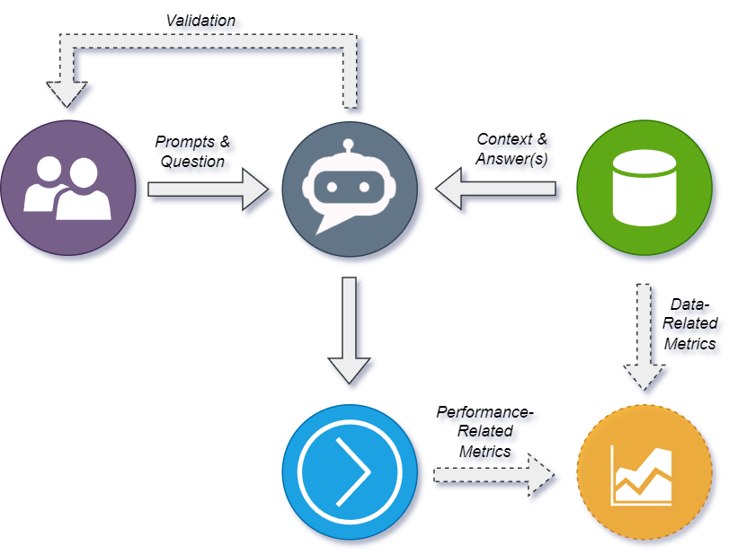
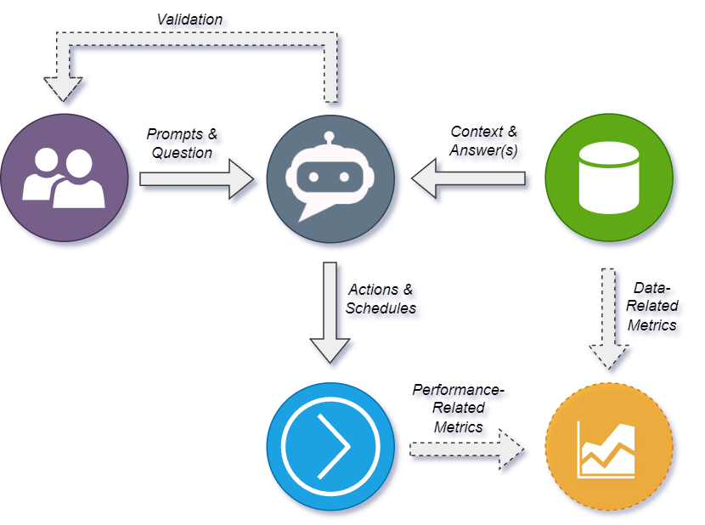

The Concept of Context Grounding in Agents (Copilots)
Agentic AI
Chatbot vs Agent

Slide 9
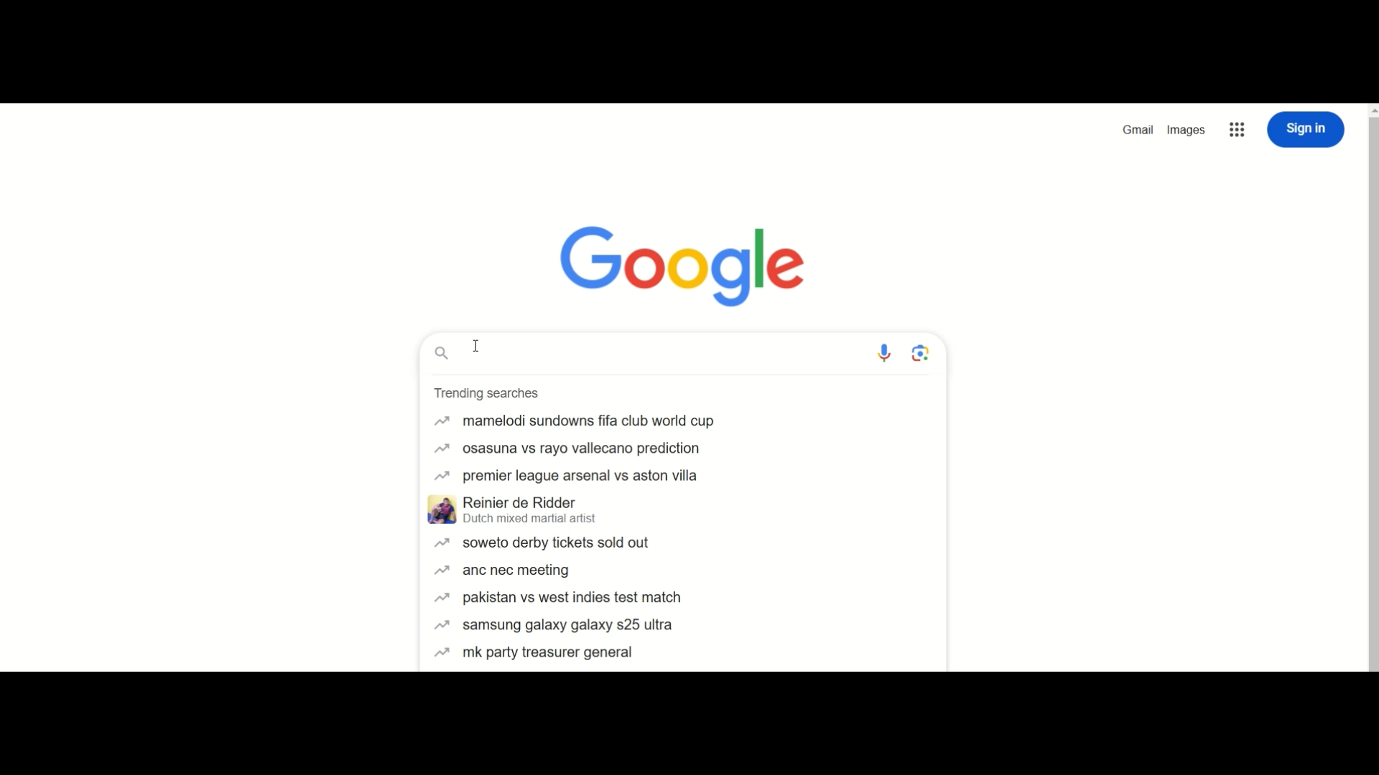

Prompting Existing Knowledge

Slide 10


Prompting Existing Knowledge – With Context

Slide 11

Limiting the Knowledge
Creating healthy boundaries
Limit Data
Limit Access
“The Unlimited”
Limit Data Sources
Limit Data Sets
Limit Access to Data Sources
Limit Access to Data Sets
Limit Access to Curated Data
Go Forth and Just Prosper
Anything goes!
Disclaimer: This is not sponsored content but if you don’t “ground” your data, maybe consider contacting The Unlimited – you may need it

Slide 12
“But WHY (and how)?” Use Cases
Productivity
Learning
IT Development
Customer Support
Email Summarisation
Task Management
Calendar Assistant
Availability Manager
Virtual Tutor
Language Learning
Course Companion
Course Comparisons
Learning Path Planner
Code Assistance & Reviewer
Infrastructure Manager
Data Analysis
Reporter
Sentiment Analysis
Proactive Support
Product Training
Business Improvement
Creative Industries
Healthcare
Sustainability
Document Drafting & Review
Budgeting Assistance
General HR Query Manager
Content Generation
Design Ideation & Capture
Script Writer/Reviewer
Medical Insights & Translation
Telemedicinal Admin & Support
Wellness Recommendation
Energy Savings Monitor
Sustainable Shopping
Carbon Footprint Tracker

Slide 13


Let’s Demo!
A thing that does stuff – A lot of stuff
Find all the content from the presentation here:
Jacqui.Muller@outlook.com

Slide 14
Thank You!
You’re welcome to ask me stuff!
If you haven’t yet, please connect!
Jacqui.Muller@outlook.com

Slide 15
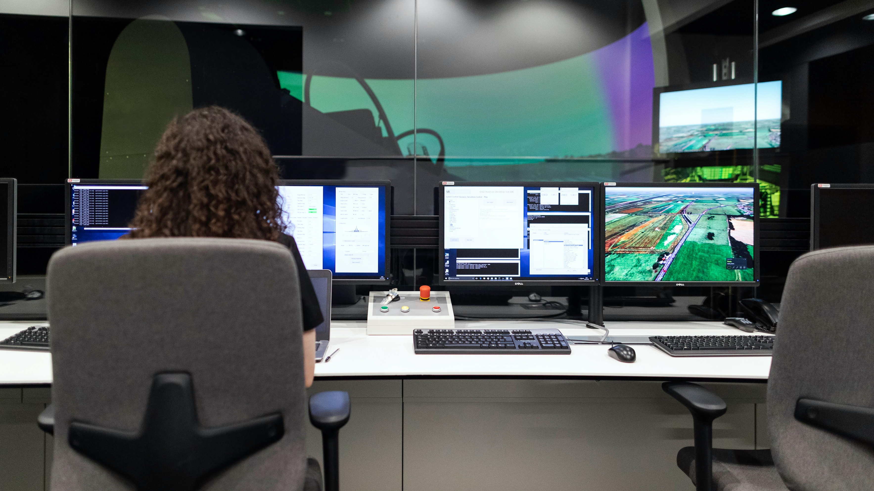
The World of
TESTING

